Slide 1
CPU Scheduling

Slide 2
CPU Scheduling
Basic Concepts
Scheduling Criteria
Scheduling Algorithms
Thread Scheduling
Multiple-Processor Scheduling
Operating Systems Examples
Algorithm Evaluation

Slide 3
Objectives
To introduce CPU scheduling, which is the basis for multi programmed operating systems
To describe various CPU-scheduling algorithms
To discuss evaluation criteria for selecting a CPU-scheduling algorithm for a particular system

Slide 4
Basic Concepts
Maximum CPU utilization obtained with multiprogramming
CPU–I/O Burst Cycle – Process execution consists of a cycle of CPU execution and I/O wait
CPU burst distribution

Slide 5
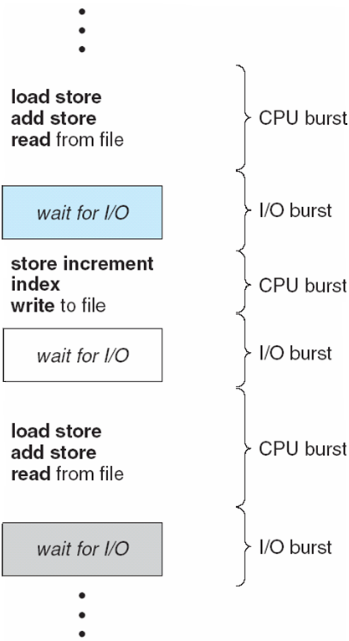
Alternating Sequence of CPU and I/O Bursts

Slide 6
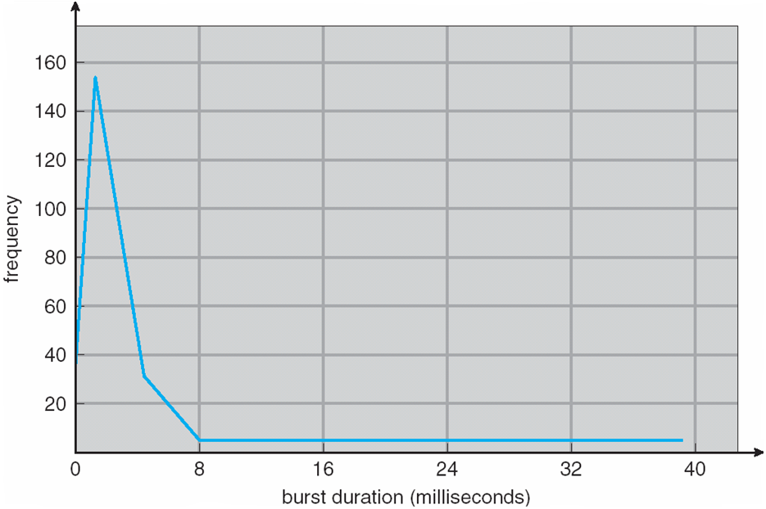
Histogram of CPU-burst Times

Slide 7
CPU Scheduler
Selects from among the processes in ready queue, and allocates the CPU to one of them
Queue may be ordered in various ways
CPU scheduling decisions may take place when a process:
1. Switches from running to waiting state
2. Switches from running to ready state
3. Switches from waiting to ready
Terminates
Scheduling under 1 and 4 is non preemptive
All other scheduling is preemptive
Consider access to shared data
Consider preemption while in kernel mode
Consider interrupts occurring during crucial OS activities

Slide 8
Preemptive and Non-Preemptive Scheduling
Non-Preemptive Scheduling: Non-preemptive Scheduling is used when a process terminates, or a process switches from running to waiting state. In this scheduling, once the resources (CPU cycles) is allocated to a process, the process holds the CPU till it gets terminated or it reaches a waiting state. In case of non-preemptive scheduling does not interrupt a process running CPU in middle of the execution. Instead, it waits till the process complete its CPU burst time and then it can allocate the CPU to another process.
Algorithms that are based on non-preemptive Scheduling are non-preemptive priority, and shortest Job first.
Preemptive Scheduling : Preemptive scheduling is used when a process switches from running state to ready state or from waiting state to ready state. The resources (mainly CPU cycles) are allocated to the process for the limited amount of time and then is taken away, and the process is again placed back in the ready queue if that process still has CPU burst time remaining. That process stays in ready queue till it gets next chance to execute.
Algorithms that are backed by preemptive Scheduling are round-robin (RR), priority, SRTF (shortest remaining time first).

Slide 9
Dispatcher
Dispatcher module gives control of the CPU to the process selected by the short-term scheduler; this involves:
switching context
switching to user mode
jumping to the proper location in the user program to restart that program
Dispatch latency – time it takes for the dispatcher to stop one process and start another running

Slide 10
Scheduling Criteria
CPU utilization – keep the CPU as busy as possible
Throughput – # of processes that complete their execution per time unit
Turnaround time – amount of time to execute a particular process
Waiting time – amount of time a process has been waiting in the ready queue
Response time – amount of time it takes from when a request was submitted until the first response is produced, not output (for time-sharing environment)

Slide 11
Scheduling Algorithm Optimization Criteria
Max CPU utilization
Max throughput
Min turnaround time
Min waiting time
Min response time

Slide 12
First-Come, First-Served (FCFS) Scheduling
Process Burst Time
P₁ 24
P₂ 3
P₃ 3
Suppose that the processes arrive in the order: P₁ , P₂ , P₃ The Gantt Chart for the schedule is:
Waiting time for P₁ = 0; P₂ = 24; P₃ = 27
Average waiting time: (0 + 24 + 27)/3 = 17
Turnaround Time for P1= Waiting Time of P1 + Burst Time of P1
= 0 +24=24
P2= 24+3=27
P3=27+3=30
Average Turnaround Time= (24+27+30)/3=27
P₁
P₂
P₃
0
24
27
30

Slide 13
FCFS Scheduling (Cont.)
Suppose that the processes arrive in the order:
P₂ , P₃ , P₁
The Gantt chart for the schedule is:
Waiting time for P₁ = 6; P₂ = 0; P₃ = 3
Average waiting time: (6 + 0 + 3)/3 = 3
Much better than previous case
Convoy effect - short process behind long process
Consider one CPU-bound and many I/O-bound processes
P₂
P₃
P₁
0
3
6
30

Slide 14
Shortest-Job-First (SJF) Scheduling
Associate with each process the length of its next CPU burst
Use these lengths to schedule the process with the shortest time
SJF is optimal – gives minimum average waiting time for a given set of processes
The difficulty is knowing the length of the next CPU request
Could ask the user

Slide 15
Example of SJF
ProcessArriva l Time Burst Time
P₁ 0.0 6
P₂ 2.0 8
P₃ 4.0 7
P₄ 5.0 3
SJF scheduling chart
Average waiting time = (3 + 16 + 9 + 0) / 4 = 7
Calculate Average Turnaround Time.
P₄
P₁
P₃
P₂
0
3
9
16
24

Slide 16
Determining Length of Next CPU Burst
Can only estimate the length – should be similar to the previous one
Then pick process with shortest predicted next CPU burst
Can be done by using the length of previous CPU bursts, using exponential averaging
Commonly, α set to ½
Preemptive version called shortest-remaining-time-first

Slide 17
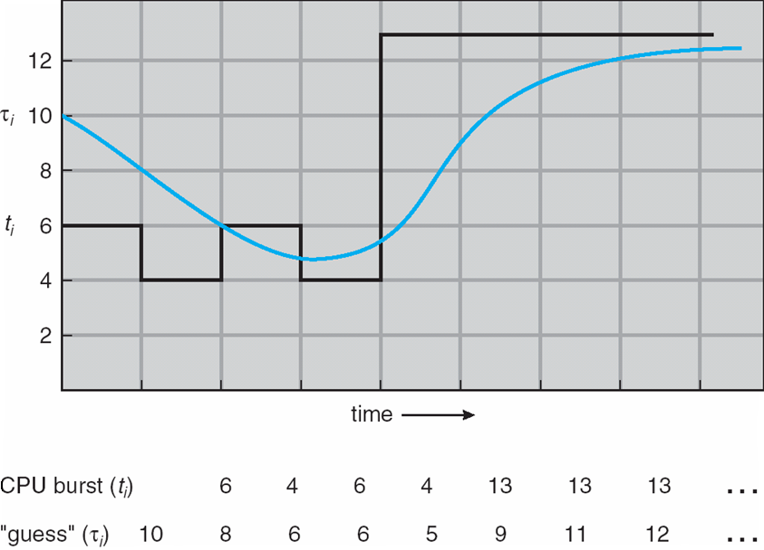
Prediction of the Length of the Next CPU Burst

Slide 18
Examples of Exponential Averaging
α =0
τ_{n+1} = τ_{n}
Recent history does not count
α =1
τ_{n+1} = α t_{n}
Only the actual last CPU burst counts
If we expand the formula, we get:
τ_{n+1} = α t_{n}+(1 - α)α t_{n} -1 + …
+(1 - α )^{j} α t_{n} _{-j} + …
+(1 - α )^{n +1} τ₀
Since both α and (1 - α) are less than or equal to 1, each successive term has less weight than its predecessor

Slide 19
Example of Shortest-remaining-time-first
Now we add the concepts of varying arrival times and preemption to the analysis
ProcessA arri Arrival TimeT Burst Time
P₁ 0 8
P₂ 1 4
P₃ 2 9
P₄ 3 5
Preemptive SJF Gantt Chart
Average waiting time = [(10-1)+(1-1)+(17-2)+5-3)]/4 = 26/4 = 6.5 msec
Average Turnaround Time = (9+8)+(0+4)+(15+9)+(2+5)=52/4= 13 msec
P₁
P₂
P₄
P₁
P₃
0
1
5
10
17
26

Slide 20
Priority Scheduling
A priority number (integer) is associated with each process
The CPU is allocated to the process with the highest priority (smallest integer ≡ highest priority)
Preemptive
Nonpreemptive
SJF is priority scheduling where priority is the inverse of predicted next CPU burst time
Problem ≡ Starvation – low priority processes may never execute
Solution ≡ Aging – as time progresses increase the priority of the process

Slide 21
Example of Priority Scheduling
ProcessA arri Burst TimeT Priority
P₁ 10 3
P₂ 1 1
P₃ 2 4
P₄ 1 5
P₅ 5 2
Priority scheduling Gantt Chart
Average waiting time = 8.2 msec
P₂
P₅
P₁
P₃
P₄
0
1
6
16
18
19

Slide 22
Round Robin (RR)
Each process gets a small unit of CPU time (time quantum q), usually 10-100 milliseconds. After this time has elapsed, the process is preempted and added to the end of the ready queue.
If there are n processes in the ready queue and the time quantum is q, then each process gets 1/n of the CPU time in chunks of at most q time units at once. No process waits more than (n-1)q time units.
Timer interrupts every quantum to schedule next process
Performance
q large ⇒ FIFO
q small ⇒ q must be large with respect to context switch, otherwise overhead is too high

Slide 23
Example of RR with Time Quantum = 4
Process Burst Time
P₁ 24
P₂ 3
P₃ 3
The Gantt chart is:
Typically, higher average turnaround than SJF, but better response
q should be large compared to context switch time
q usually 10ms to 100ms, context switch < 10 usec
Waiting Time: P1= (0-0)+(10-4)=6 , P2=(4-0)=4, P3=(7-0)=7
AWT=17/3=5.66 msec
ATT=47/3=15.66 msec
P₁
P₂
P₃
P₁
P₁
P₁
P₁
P₁
0
4
7
10
14
18
22
26
30

Slide 24
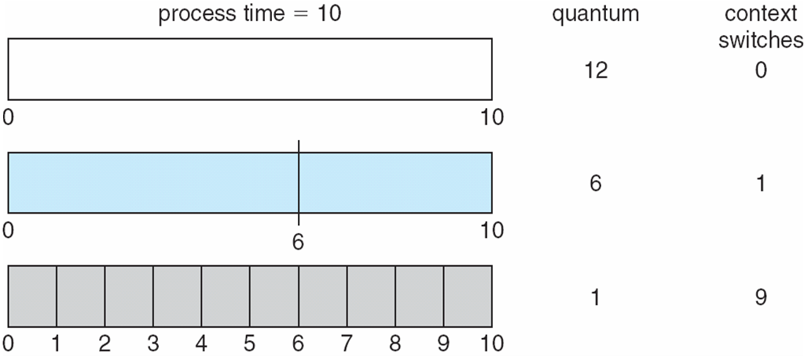
Time Quantum and Context Switch Time

Slide 25
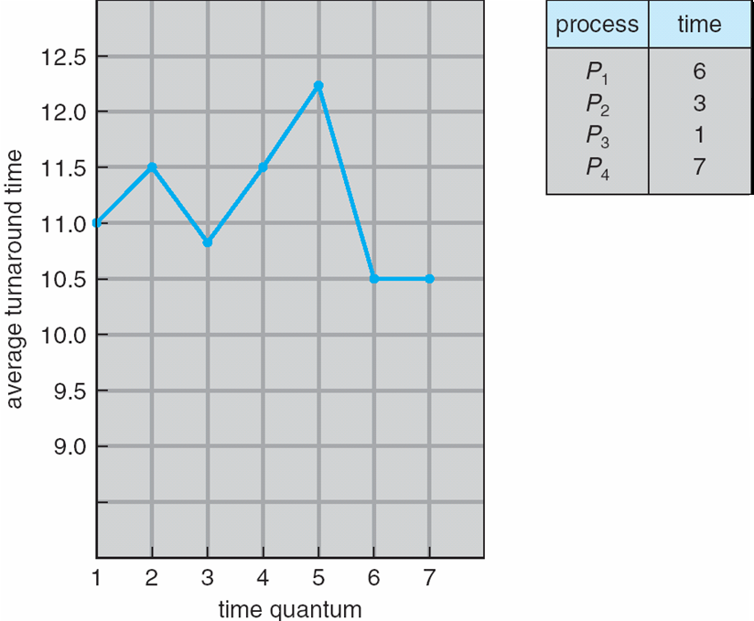
Turnaround Time Varies With The Time Quantum
80% of CPU bursts should be shorter than q

Slide 26
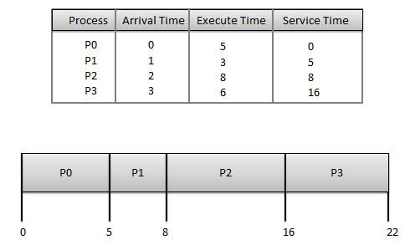
FCFS-Different Arrival Time

Slide 27
Wait time of each process is as follows −
Process Wait Time : Service Time - Arrival Time
P0 0 - 0 = 0
P1 5 - 1 = 4
P2 8 - 2 = 6
P3 16 - 3 = 13
Average Wait Time: (0+4+6+13) / 4 = 5.75
Calculate Average Turnaround Time ?

Slide 28
Apply Shortest Job First Non-Preemptive and Preemptive
Process | Arrival Time | Execution Time
P0 | 0 | 5
P1 | 1 | 3
P2 | 2 | 8
P3 | 3 | 6

Slide 29
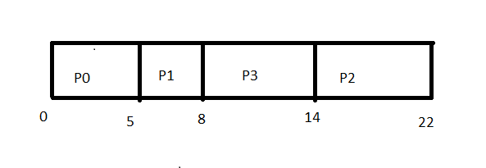
Gannt Chart for SJF Non-Preemptive

Slide 30
Calculate AWT and ATT
Waiting time of each process is as follows −
Process Waiting Time
P0 0 - 0 = 0
P1 5 - 1 = 4
P2 14 - 2 = 12
P3 8 - 3 = 5
Average Wait Time: (0 + 4 + 12 + 5)/4 = 21 / 4 = 5.25
Turnaround Time = Waiting Time + Burst time
P0=0+5=5
p1=4+3=7
P2=12+8=20
P3=5+6=11
ATT=43/4=10.75 msec

Slide 31
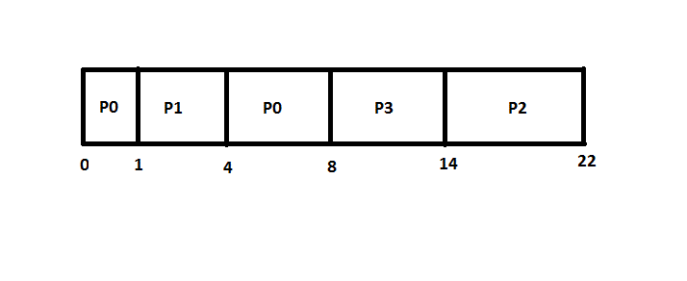
Gannt Chart for SJF-Preemptive

Slide 32
Waiting time of each process is as follows −
Process Waiting Time
P0: (0-0)+(4-1)=3
P1: (1-1)=0
P2: (14-2)=12
P3:(8-3)=5
Average Wait Time: (3+ 0 + 12 + 5)/4 = 20 / 4 = 5 msec
Calculate Average Turnaround Time ?

Slide 33
Example of Preemptive SJF
Now we add the concepts of varying arrival times and preemption to the analysis
ProcessA arri Arrival TimeT Burst Time
P₁ 0 8
P₂ 1 4
P₃ 2 9
P₄ 3 5
Preemptive SJF Gantt Chart
Waiting Time: P₁ =(0-0)+(10-1)=9, P2=(1-1)=0, P3=(17-2)=15, P4=(5-3)=2
Average waiting time = 26/4 = 6.5 msec
Turnaround Time= Waiting Time + Burst Time
P1 =9+8=17, P2=0+4=4, P3=15+9=24, P4=2+5=7
Average Turnaround Time = 17+4+24+7= 13 msec
P₁
P₂
P₄
P₁
P₃
0
1
5
10
17
26

Slide 34
SJF with Preemption
Process ID | Arrival Time | Burst Time
1 | 0 | 8
2 | 1 | 4
3 | 2 | 2
4 | 3 | 1
5 | 4 | 3
6 | 5 | 2

Slide 35
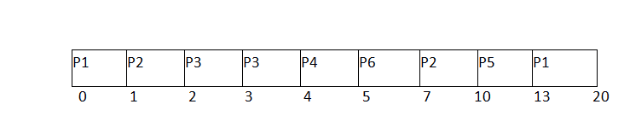
Gannt Chart

Slide 36
Waiting Time : P1=(0-0)+(13-1)=12 P4=(4-3)=1
P2=(1-1)+(7-2)=5 P5=(10-4)=6
P3=(2-2)=0 P6=(5-5)=0
Average Waiting Time = (12+5+0+1+6+0)/6=4 msec
Turnaround Time : Waiting Time + Burst Time
P1=12+8=20 P4=1+1=2
P2=5+4=9 P5=6+3=9
P3=0+2=2 P6=0+2=2
Average Turnaround Time = (20+9+2+2+9+2)/6=7.66 msec

Slide 37
Apply Priority Non-Preemptive and Preemptive
PROCESS | ARRIVAL TIME | BURST TIME | PRIORITY
P1 | 0 | 8 | 3
P2 | 1 | 1 | 1
P3 | 2 | 3 | 2
P4 | 3 | 2 | 3
P5 | 4 | 6 | 4

Slide 38
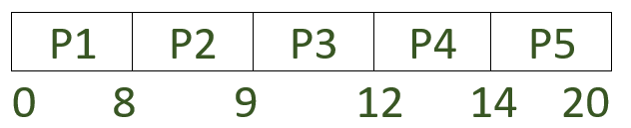
Gannt Chart for Priority Non-Preemptive
Average waiting time (AWT)= ((0-0) + (8-1) + (9-2) + (12-3) + (14-4)) / 5
= 33 / 5
= 6.6 msec
Average turnaround time (TAT)= ((0+8)+(7+1)+(7+3)+(9+2)+(10+6))/5
=53/5
=10.6 msec

Slide 39
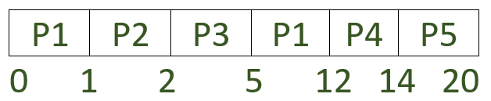
Gannt Chart for Priority Preemptive
Average waiting time (AWT) = ((5-1) + (1-1) + (2-2) + (12-3) + (14-4)) / 5
= 23/5
= 4.6 msec
Average Turnaround time (ATT)= ((4+8)+(0+1)+(0+3)+(9+2)+(10+6))/5
=43/5
=8.6 msec

Slide 40
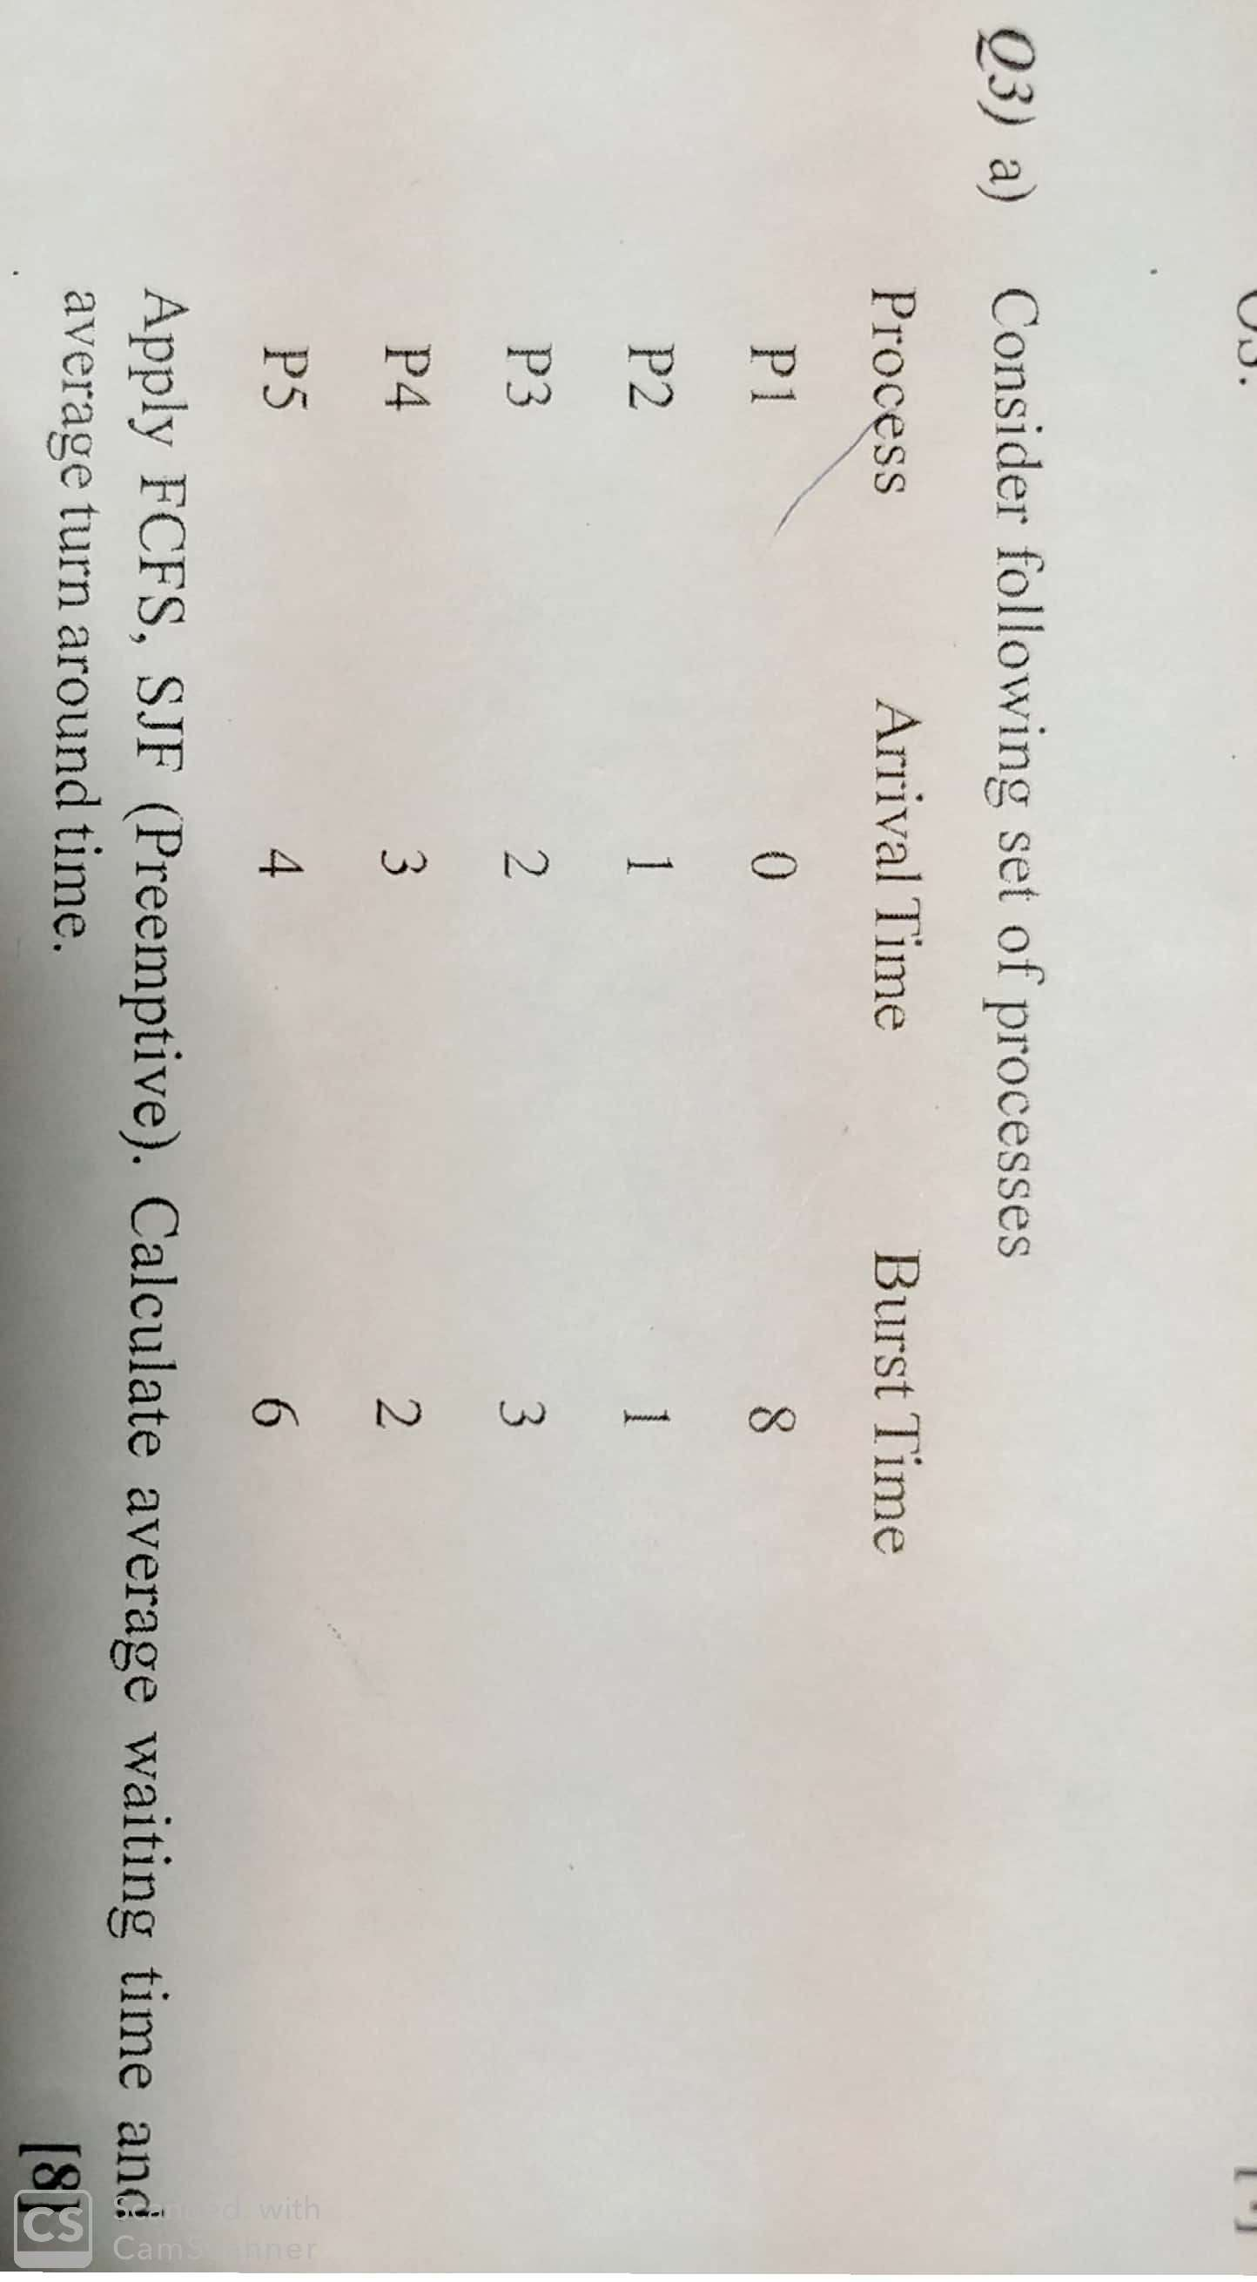

Slide 41
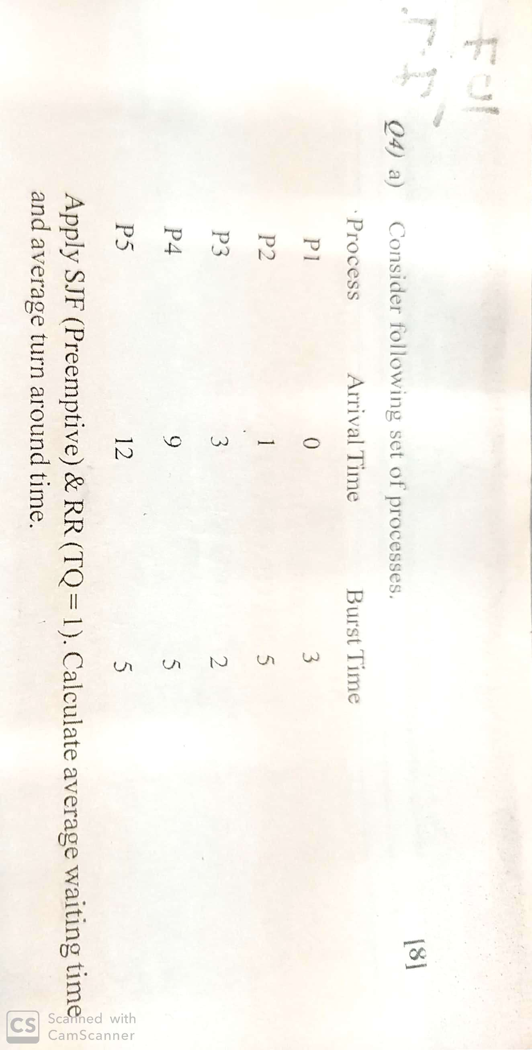

Slide 42
Multilevel Queue
Ready queue is partitioned into separate queues, eg:
foreground (interactive)
background (batch)
Process permanently in a given queue
Each queue has its own scheduling algorithm:
foreground – RR
background – FCFS
Scheduling must be done between the queues:
Fixed priority scheduling; (i.e., serve all from foreground then from background). Possibility of starvation.
Time slice – each queue gets a certain amount of CPU time which it can schedule amongst its processes; i.e., 80% to foreground in RR
20% to background in FCFS

Slide 43
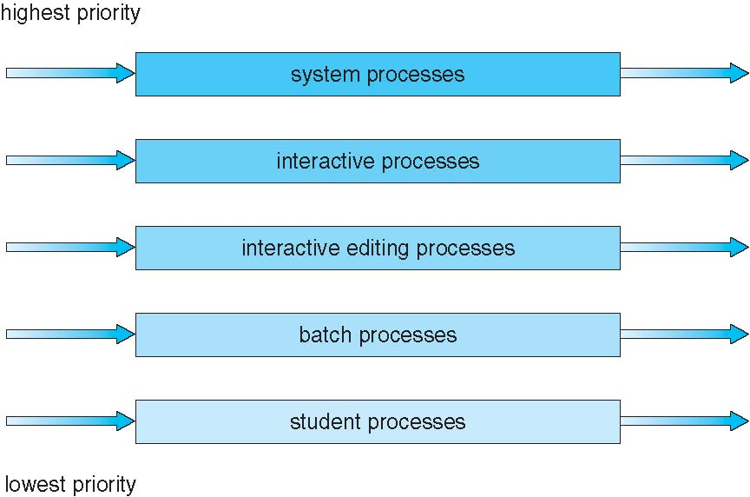
Multilevel Queue Scheduling

Slide 44
Multilevel Feedback Queue
A process can move between the various queues; aging can be implemented this way
Multilevel-feedback-queue scheduler defined by the following parameters:
number of queues
scheduling algorithms for each queue
method used to determine when to upgrade a process
method used to determine when to demote a process
method used to determine which queue a process will enter when that process needs service

Slide 45
Example of Multilevel Feedback Queue
Three queues:
Q₀ – RR with time quantum 8 milliseconds
Q₁ – RR time quantum 16 milliseconds
Q₂ – FCFS
Scheduling
A new job enters queue Q₀ which is served FCFS
When it gains CPU, job receives 8 milliseconds
If it does not finish in 8 milliseconds, job is moved to queue Q₁
At Q₁ job is again served FCFS and receives 16 additional milliseconds
If it still does not complete, it is preempted and moved to queue Q₂

Slide 46
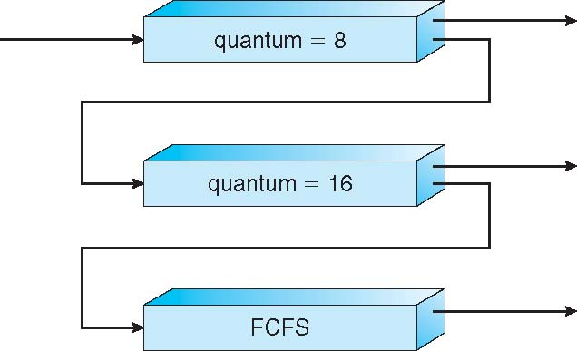
Multilevel Feedback Queues

Slide 47
Thread Scheduling
Distinction between user-level and kernel-level threads
When threads supported, threads scheduled, not processes
Many-to-one and many-to-many models, thread library schedules user-level threads to run on LWP
Known as process-contention scope (PCS) since scheduling competition is within the process
Typically done via priority set by programmer
Kernel thread scheduled onto available CPU is system-contention scope (SCS) – competition among all threads in system

Slide 48
Pthread Scheduling
API allows specifying either PCS or SCS during thread creation
PTHREAD_SCOPE_PROCESS schedules threads using PCS scheduling
PTHREAD_SCOPE_SYSTEM schedules threads using SCS scheduling
Can be limited by OS – Linux and Mac OS X only allow PTHREAD_SCOPE_SYSTEM

Slide 49
Pthread Scheduling API
#include <pthread.h>
#include <stdio.h>
#define NUM THREADS 5
int main(int argc, char *argv[])
{
int i;
pthread t tid[NUM THREADS];
pthread attr t attr;
/* get the default attributes */
pthread attr init(&attr);
/* set the scheduling algorithm to PROCESS or SYSTEM */
pthread attr setscope(&attr, PTHREAD SCOPE SYSTEM);
/* set the scheduling policy - FIFO, RT, or OTHER */
pthread attr setschedpolicy(&attr, SCHED OTHER);
/* create the threads */
for (i = 0; i < NUM THREADS; i++)
pthread create(&tid[i],&attr,runner,NULL);

Slide 50
Pthread Scheduling API
/* now join on each thread */
for (i = 0; i < NUM THREADS; i++)
pthread join(tid[i], NULL);
}
/* Each thread will begin control in this function */
void *runner(void *param)
{
printf("I am a thread\n");
pthread exit(0);
}

Slide 51
Multiple-Processor Scheduling
CPU scheduling more complex when multiple CPUs are available
Homogeneous processors within a multiprocessor
Asymmetric multiprocessing – only one processor accesses the system data structures, alleviating the need for data sharing
Symmetric multiprocessing (SMP) – each processor is self-scheduling, all processes in common ready queue, or each has its own private queue of ready processes
Currently, most common
Processor affinity – process has affinity for processor on which it is currently running
soft affinity
hard affinity
Variations including processor sets

Slide 52
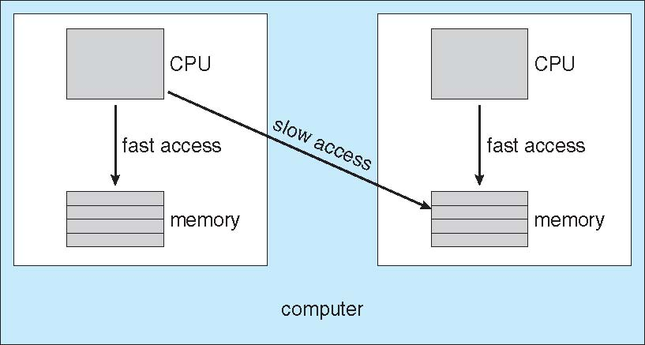
NUMA and CPU Scheduling
Note that memory-placement algorithms can also consider affinity

Slide 53
Multicore Processors
Recent trend to place multiple processor cores on same physical chip
Faster and consumes less power
Multiple threads per core also growing
Takes advantage of memory stall to make progress on another thread while memory retrieve happens

Slide 54
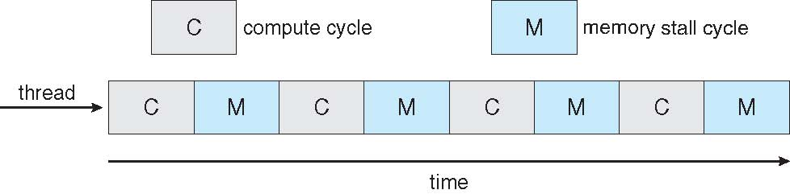

Multithreaded Multicore System

Slide 55
Virtualization and Scheduling
Virtualization software schedules multiple guests onto CPU(s)
Each guest doing its own scheduling
Not knowing it doesn’t own the CPUs
Can result in poor response time
Can effect time-of-day clocks in guests
Can undo good scheduling algorithm efforts of guests

Slide 56
Operating System Examples
Solaris scheduling
Windows XP scheduling
Linux scheduling

Slide 57
Solaris
Priority-based scheduling
Six classes available
Time sharing (default)
Interactive
Real time
System
Fair Share
Fixed priority
Given thread can be in one class at a time
Each class has its own scheduling algorithm
Time sharing is multi-level feedback queue
Loadable table configurable by sysadmin

Slide 58
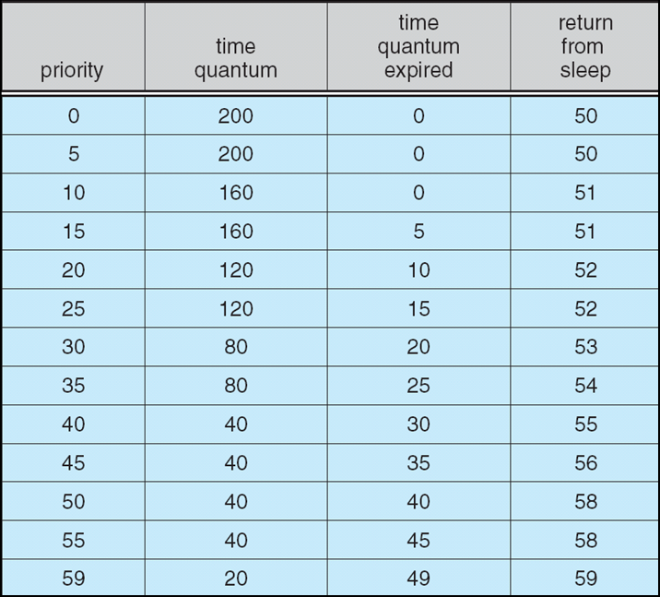
Solaris Dispatch Table

Slide 59
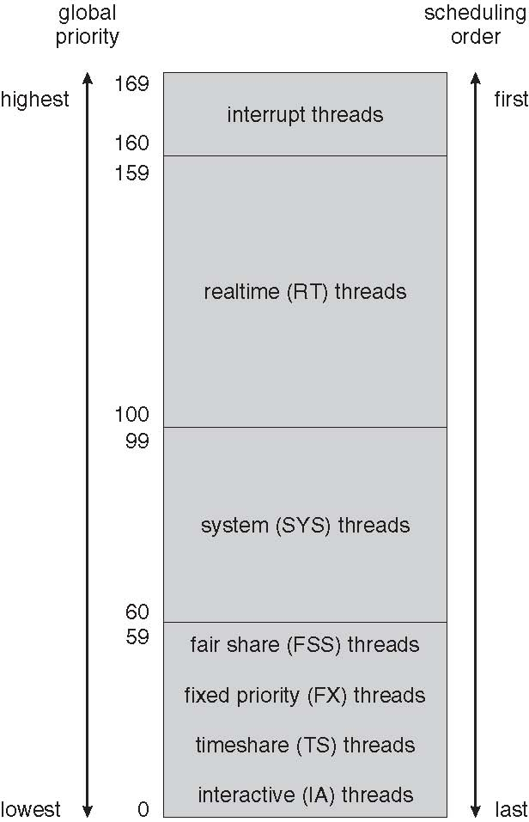
Solaris Scheduling

Slide 60
Solaris Scheduling (Cont.)
Scheduler converts class-specific priorities into a per-thread global priority
Thread with highest priority runs next
Runs until (1) blocks, (2) uses time slice, (3) preempted by higher-priority thread
Multiple threads at same priority selected via RR

Slide 61
Windows Scheduling
Windows uses priority-based preemptive scheduling
Highest-priority thread runs next
Dispatcher is scheduler
Thread runs until (1) blocks, (2) uses time slice, (3) preempted by higher-priority thread
Real-time threads can preempt non-real-time
32-level priority scheme
Variable class is 1-15, real-time class is 16-31
Priority 0 is memory-management thread
Queue for each priority
If no run-able thread, runs idle thread

Slide 62
Windows Priority Classes
Win32 API identifies several priority classes to which a process can belong
REALTIME_PRIORITY_CLASS, HIGH_PRIORITY_CLASS, ABOVE_NORMAL_PRIORITY_CLASS,NORMAL_PRIORITY_CLASS, BELOW_NORMAL_PRIORITY_CLASS, IDLE_PRIORITY_CLASS
All are variable except REALTIME
A thread within a given priority class has a relative priority
TIME_CRITICAL, HIGHEST, ABOVE_NORMAL, NORMAL, BELOW_NORMAL, LOWEST, IDLE
Priority class and relative priority combine to give numeric priority
Base priority is NORMAL within the class
If quantum expires, priority lowered, but never below base
If wait occurs, priority boosted depending on what was waited for
Foreground window given 3x priority boost

Slide 63
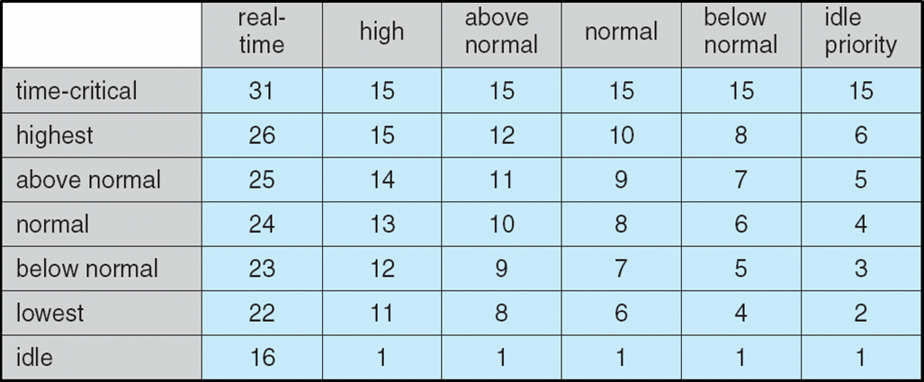
Windows XP Priorities

Slide 64
Linux Scheduling
Constant order O(1) scheduling time
Preemptive, priority based
Two priority ranges: time-sharing and real-time
Real-time range from 0 to 99 and nice value from 100 to 140
Map into global priority with numerically lower values indicating higher priority
Higher priority gets larger q
Task run-able as long as time left in time slice (active)
If no time left (expired), not run-able until all other tasks use their slices
All run-able tasks tracked in per-CPU runqueue data structure
Two priority arrays (active, expired)
Tasks indexed by priority
When no more active, arrays are exchanged

Slide 65
Linux Scheduling (Cont.)
Real-time scheduling according to POSIX.1b
Real-time tasks have static priorities
All other tasks dynamic based on nice value plus or minus 5
Interactivity of task determines plus or minus
More interactive -> more minus
Priority recalculated when task expired
This exchanging arrays implements adjusted priorities

Slide 66
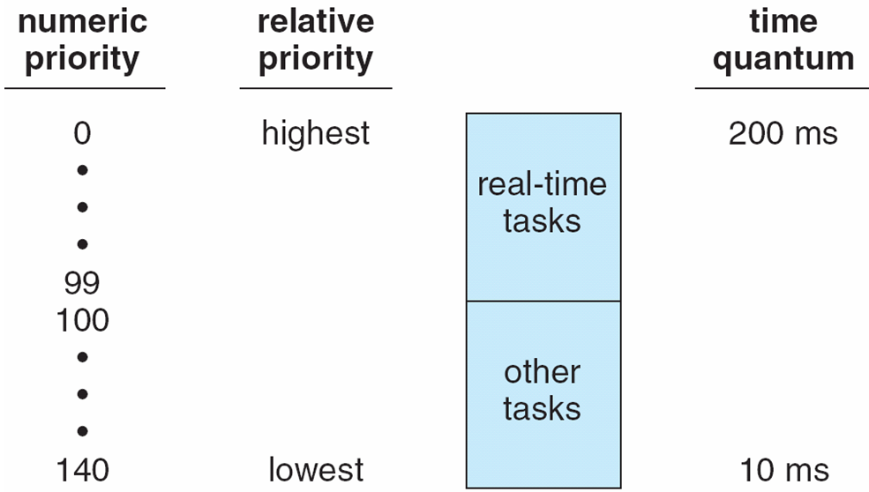
Priorities and Time-slice length

Slide 67
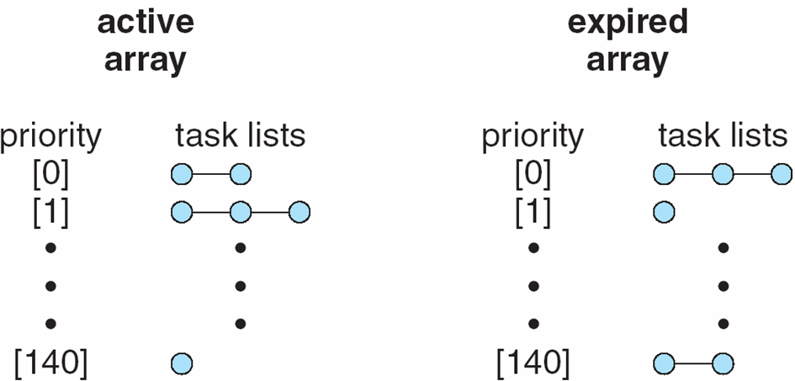
List of Tasks Indexed According to Priorities

Slide 68
Algorithm Evaluation
How to select CPU-scheduling algorithm for an OS?
Determine criteria, then evaluate algorithms
Deterministic modeling
Type of analytic evaluation
Takes a particular predetermined workload and defines the performance of each algorithm for that workload

Slide 69
Queueing Models
Describes the arrival of processes, and CPU and I/O bursts probabilistically
Commonly exponential, and described by mean
Computes average throughput, utilization, waiting time, etc
Computer system described as network of servers, each with queue of waiting processes
Knowing arrival rates and service rates
Computes utilization, average queue length, average wait time, etc

Slide 70
Little’s Formula
n = average queue length
W = average waiting time in queue
λ = average arrival rate into queue
Little’s law – in steady state, processes leaving queue must equal processes arriving, thus n = λ x W
Valid for any scheduling algorithm and arrival distribution
For example, if on average 7 processes arrive per second, and normally 14 processes in queue, then average wait time per process = 2 seconds

Slide 71
Simulations
Queueing models limited
Simulations more accurate
Programmed model of computer system
Clock is a variable
Gather statistics indicating algorithm performance
Data to drive simulation gathered via
Random number generator according to probabilities
Distributions defined mathematically or empirically
Trace tapes record sequences of real events in real systems

Slide 72
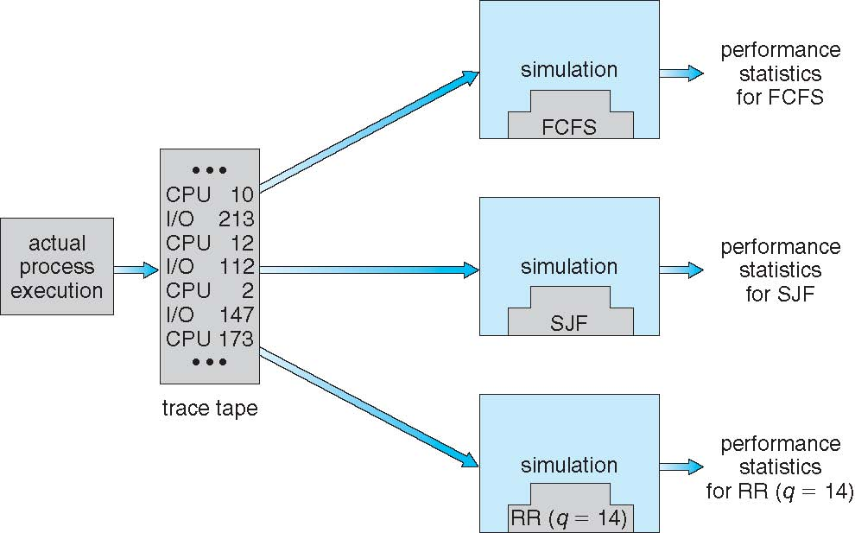
Evaluation of CPU Schedulers by Simulation

Slide 73
Implementation
Even simulations have limited accuracy
Just implement new scheduler and test in real systems
High cost, high risk
Environments vary
Most flexible schedulers can be modified per-site or per-system
Or APIs to modify priorities
But again environments vary

Slide 74
End of Chapter 5

Slide 75
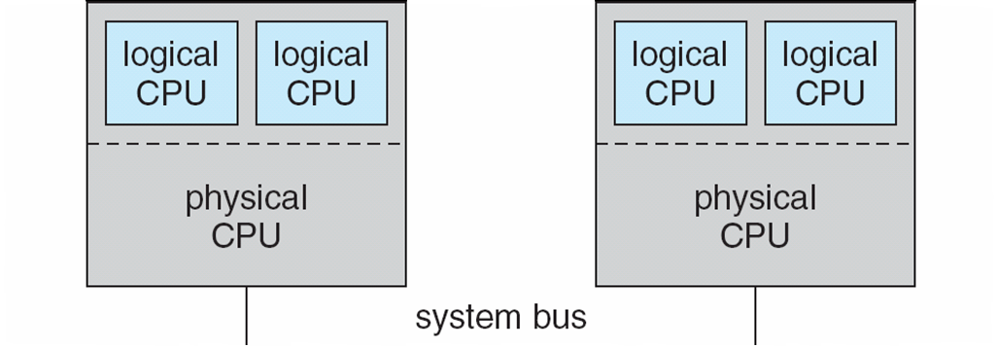
5.08

Slide 76
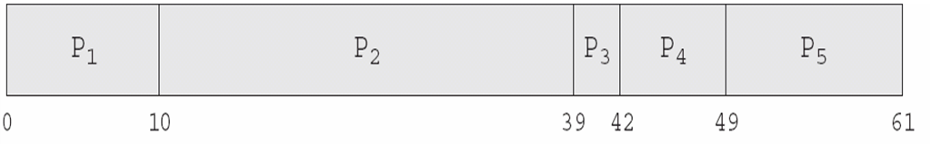
In-5.7

Slide 77
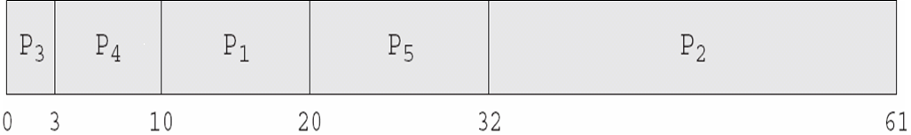
In-5.8

Slide 78
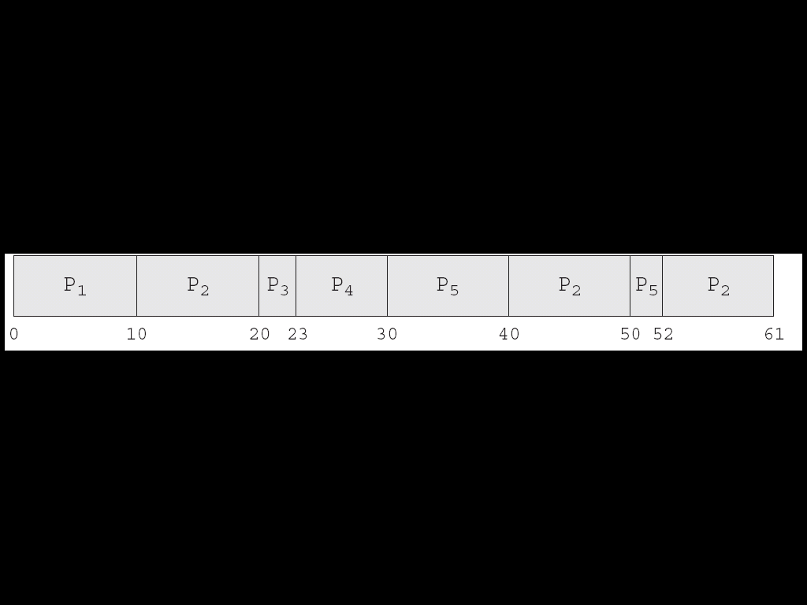
In-5.9

Slide 79
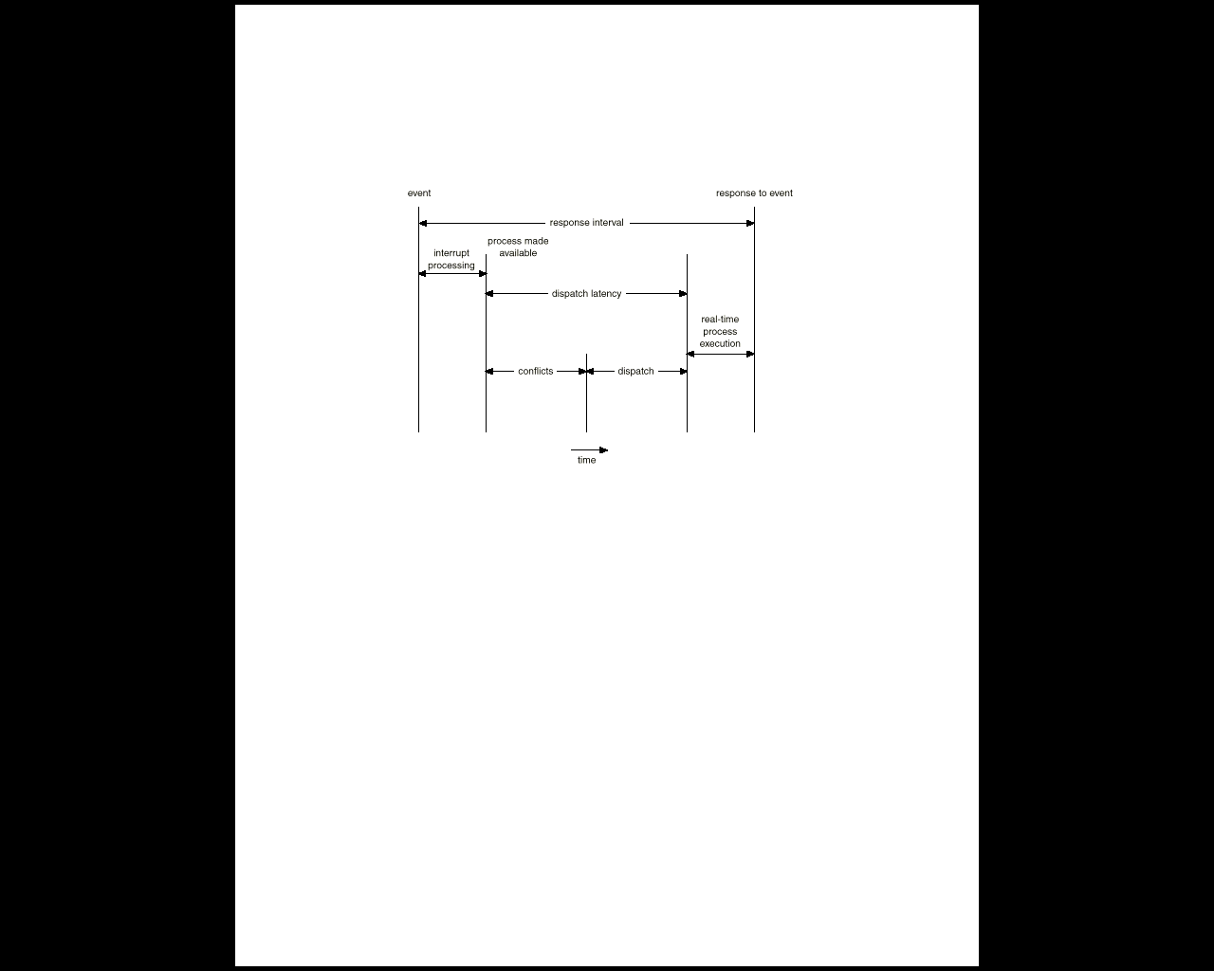
Dispatch Latency

Slide 80
Java Thread Scheduling
JVM Uses a Preemptive, Priority-Based Scheduling Algorithm
FIFO Queue is Used if There Are Multiple Threads With the Same Priority

Slide 81
Java Thread Scheduling (Cont.)
JVM Schedules a Thread to Run When:
The Currently Running Thread Exits the Runnable State
A Higher Priority Thread Enters the Runnable State
* Note – the JVM Does Not Specify Whether Threads are Time-Sliced or Not

Slide 82
Time-Slicing
Since the JVM Doesn’t Ensure Time-Slicing, the yield() Method
May Be Used:
while (true) {
// perform CPU-intensive task
. . .
Thread.yield();
}
This Yields Control to Another Thread of Equal Priority

Slide 83
Thread Priorities
Priority Comment
Thread.MIN_PRIORITY Minimum Thread Priority
Thread.MAX_PRIORITY Maximum Thread Priority
Thread.NORM_PRIORITY Default Thread Priority
Priorities May Be Set Using setPriority() method:
setPriority(Thread.NORM_PRIORITY + 2);

Slide 84
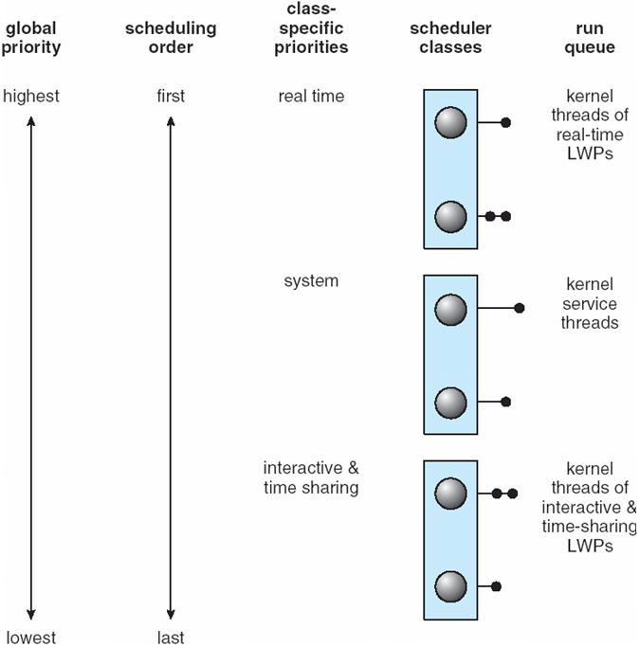
Solaris 2 Scheduling

